Slide 1
APSIM
Vision and Strategy
Neil Huth and Dean Holzworth

Slide 2
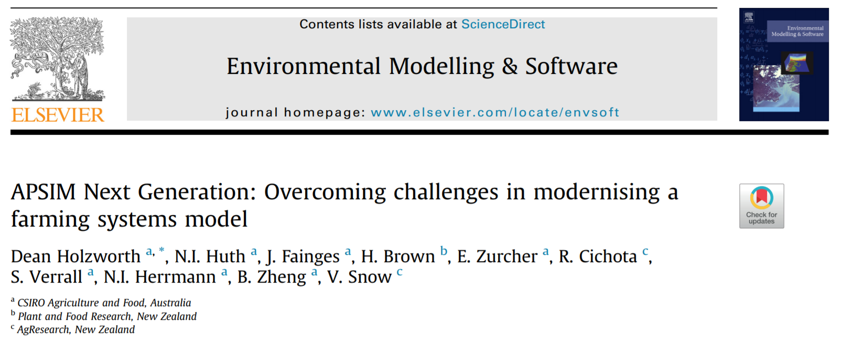
APSIM Next Generation: Why aren’t you using it?
First released August 2015
APSIM 7.8 2016 was last CSIRO Software Team involvement.

Slide 3
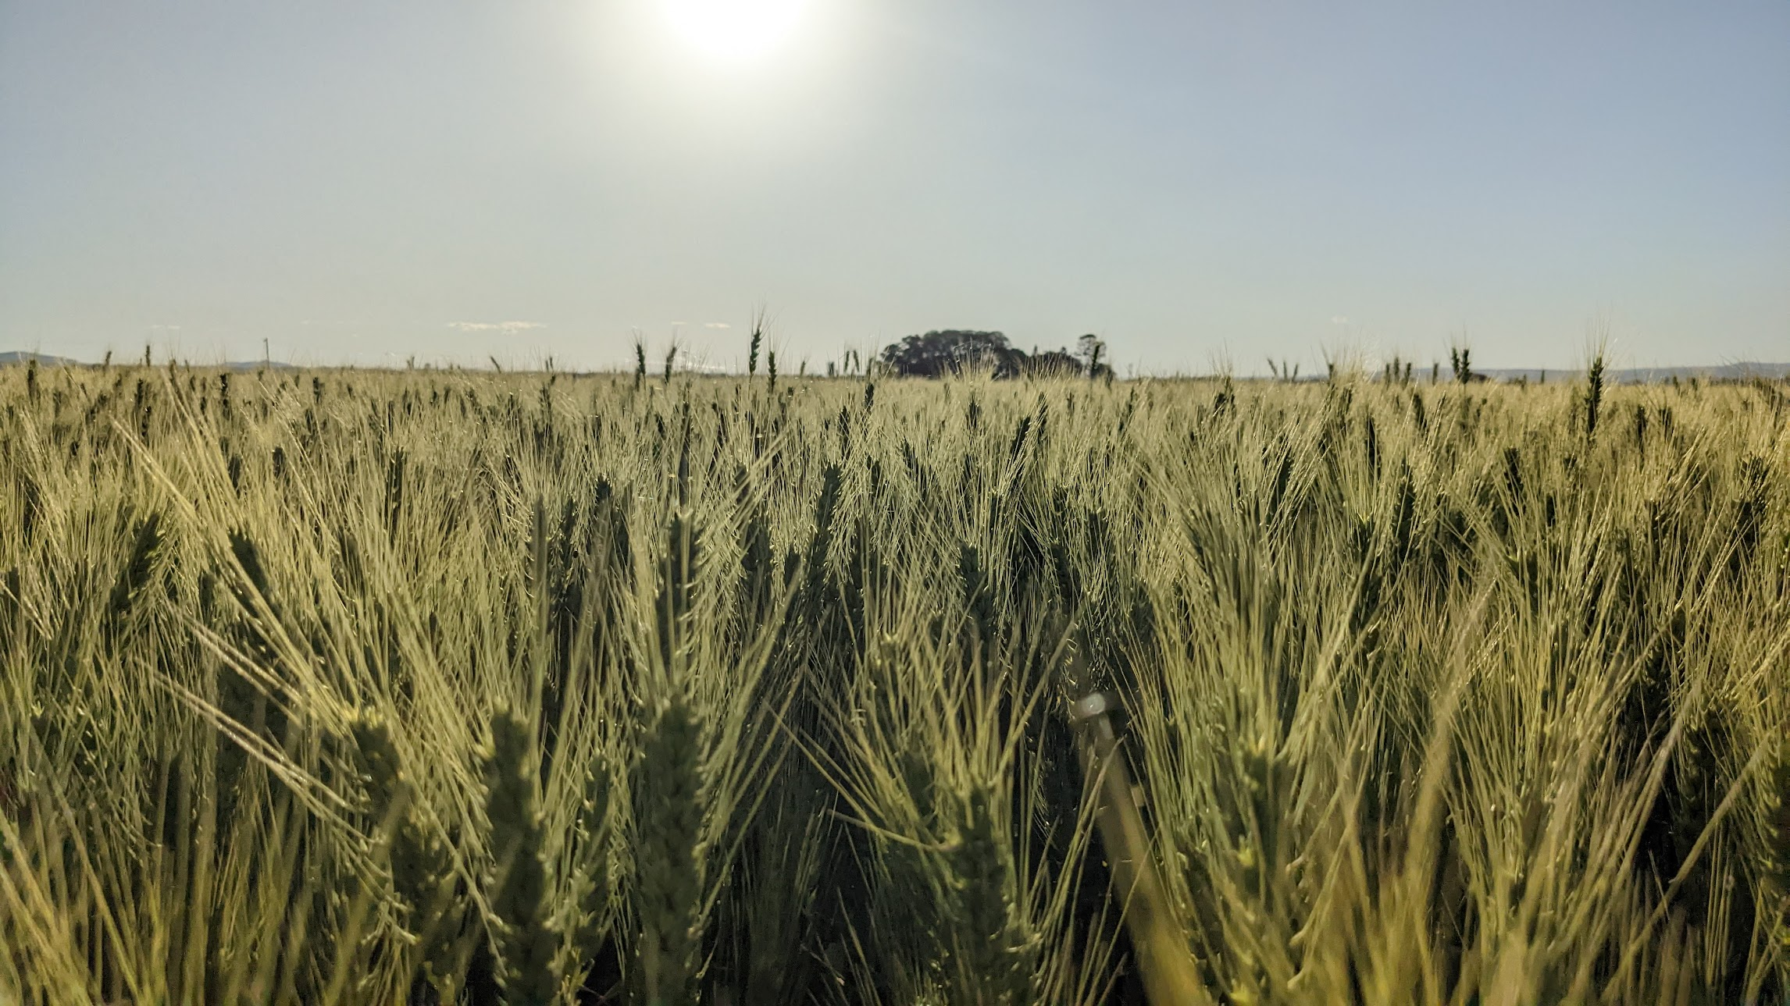
Current plant models
AgPasture (x11)
Barley
Canola
Chickpea
Chicory
Eucalyptus
FodderBeet
Gliricidia
Grapevine
Maize
Oats
Oil Palm
Peanut
Pinus
Plaintain
Potato
RedClover
Scrum
Slurp
Soybean
Sugarcane
Wheat
WhiteClover
Mungbean
Sorghum
Upland Rice *
Forage Brassica *
GrazPlan Pasture *
* Under Development

Slide 4
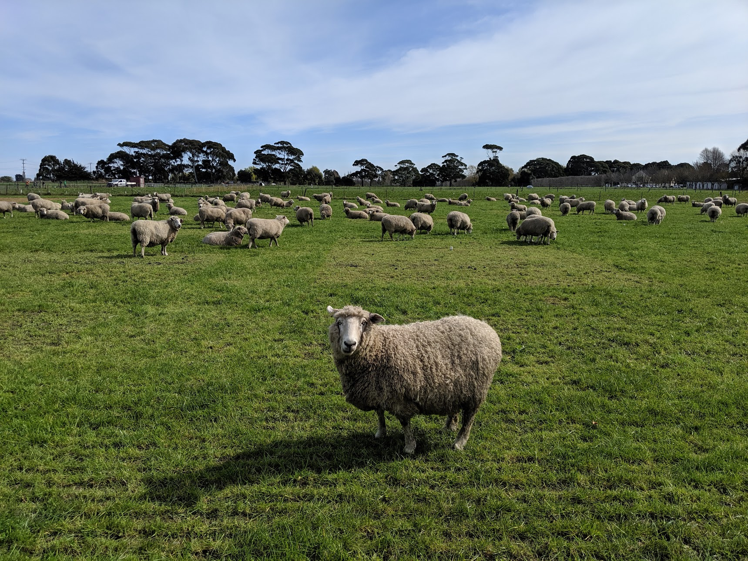
Other models/features
Stock Model (Cattle, Sheep)
Grazing impacts on crops
Nutrient model for flexibility in modelling C & N dynamics
Soil P Model implemented, but no response in crops
Pest/disease model (e.g. rust, black leg, mouse damage) with impacts on crops.
SWIM3 – Richards’ Equation water balance
Morris and Sobol Sensitivity Analyses
Better System for Experiments
Faster Runtime and Graphing

Slide 5



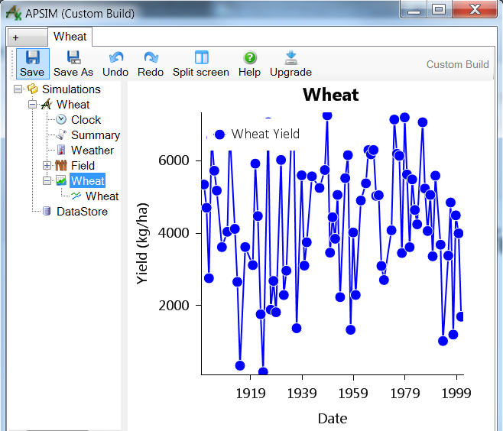
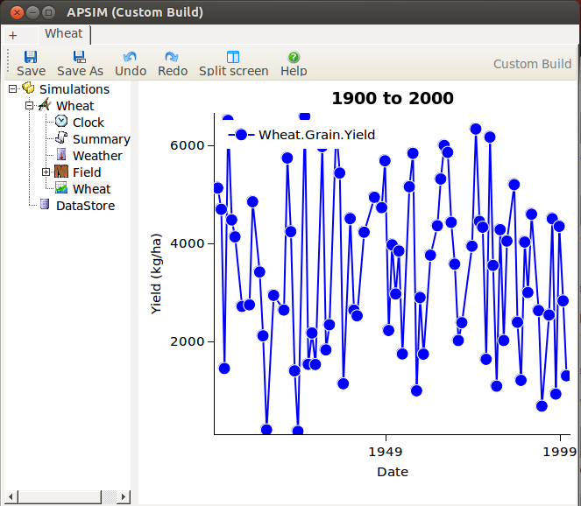
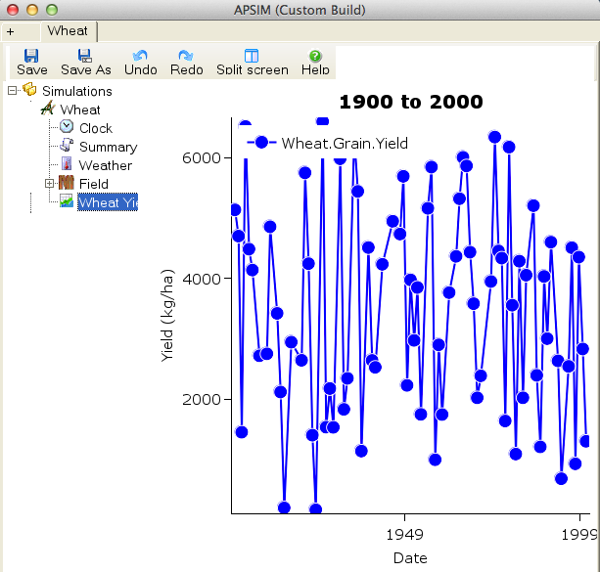

Slide 6
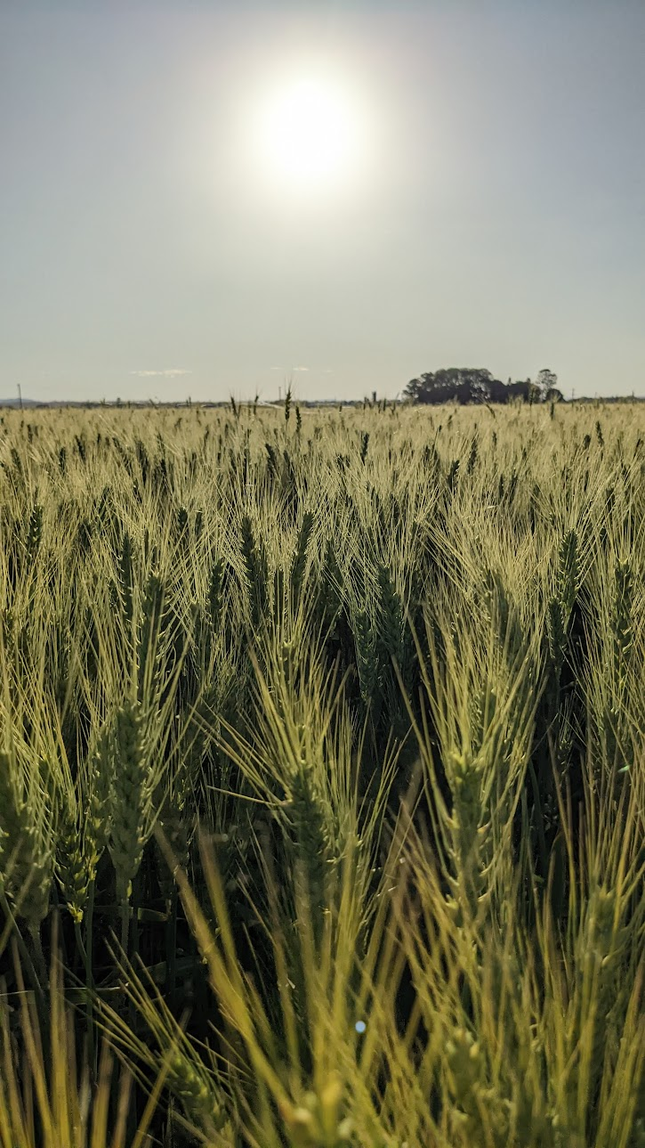
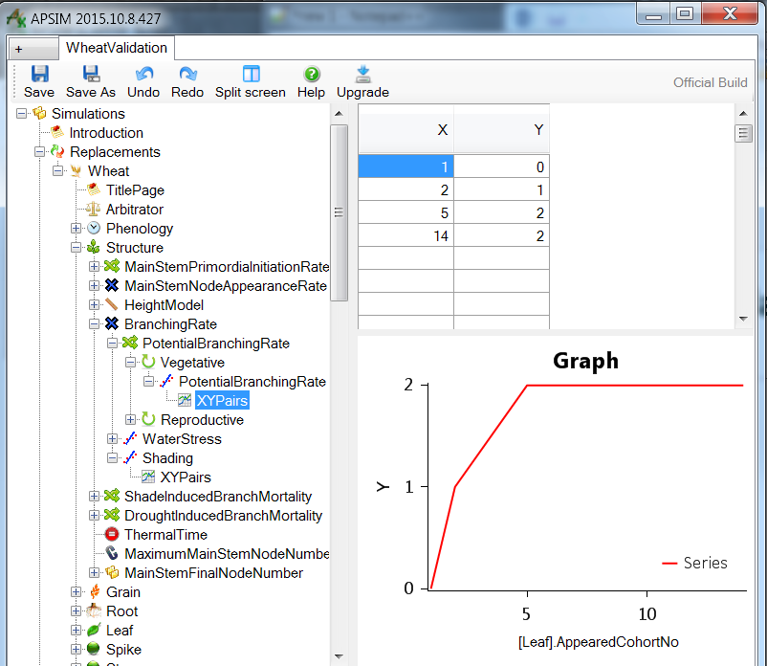
A better way to build plant models
Brown HE, Huth NI, Holzworth DP, Teixeira EI, Zyskowski RF, Hargreaves JNG, Moot DJ (2014a) Plant Modelling Framework: Software for building and running crop models on the APSIM platform. Environmental Modelling & Software 62, 385–398.

Slide 7

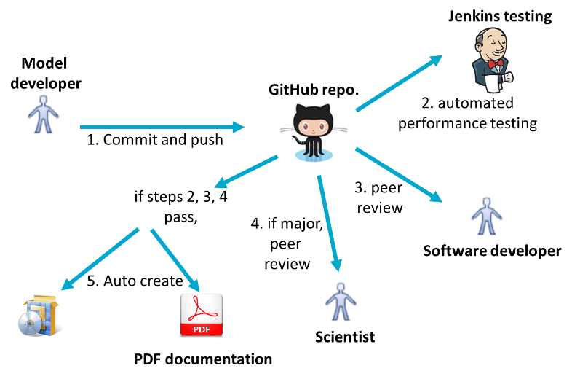
Better software processes

Slide 8
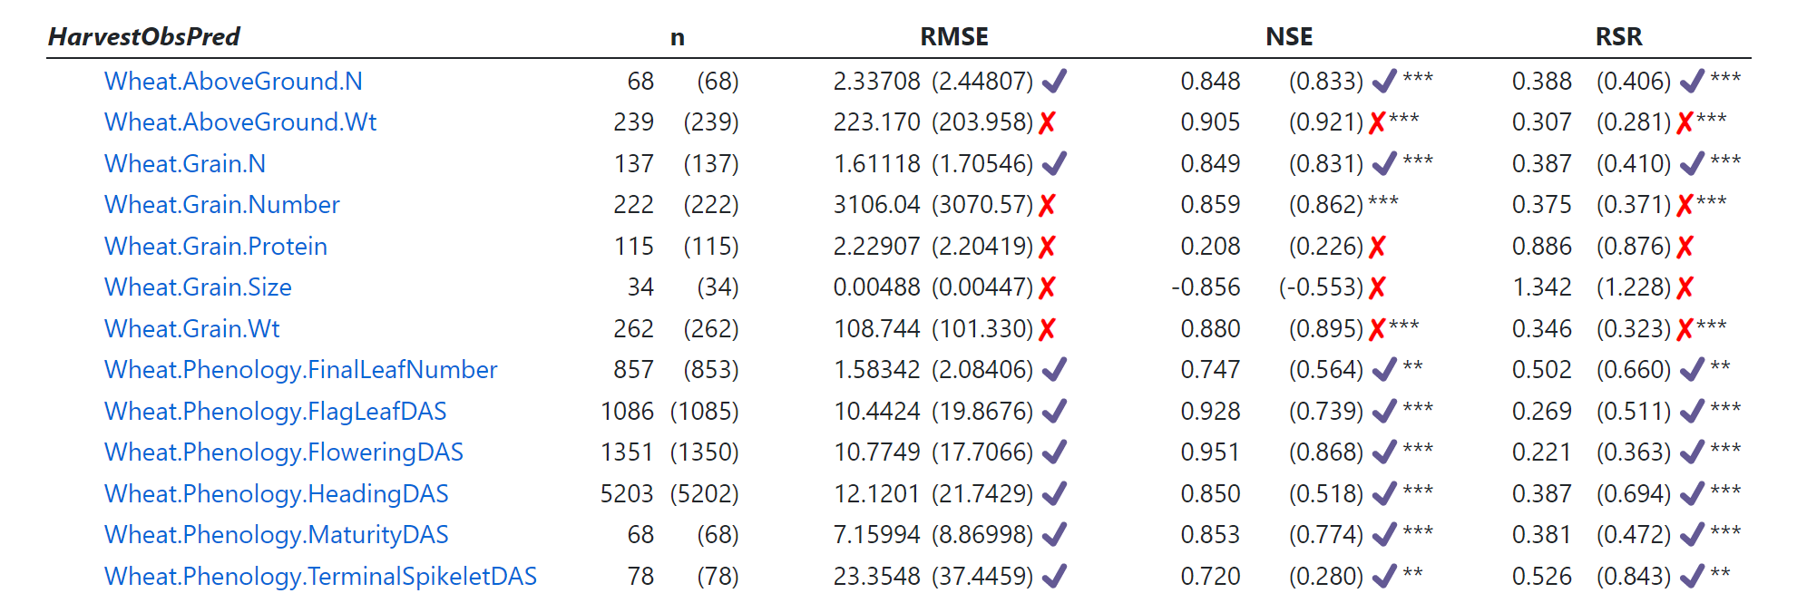
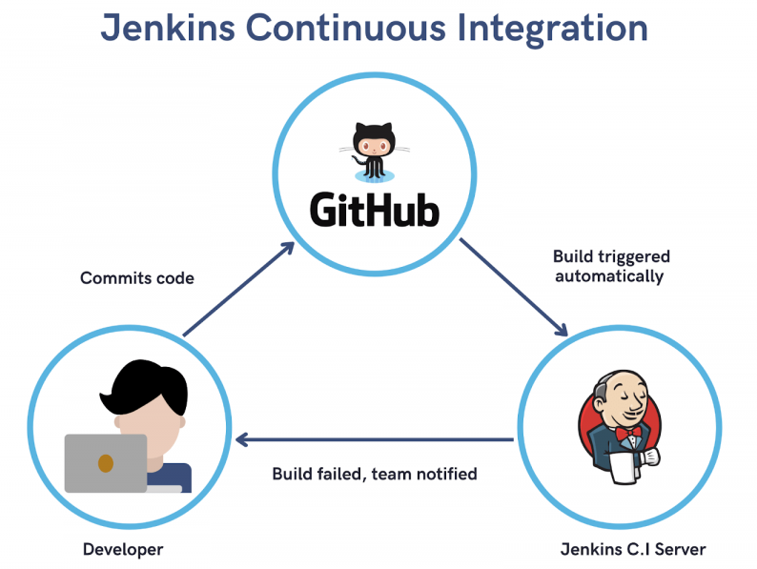
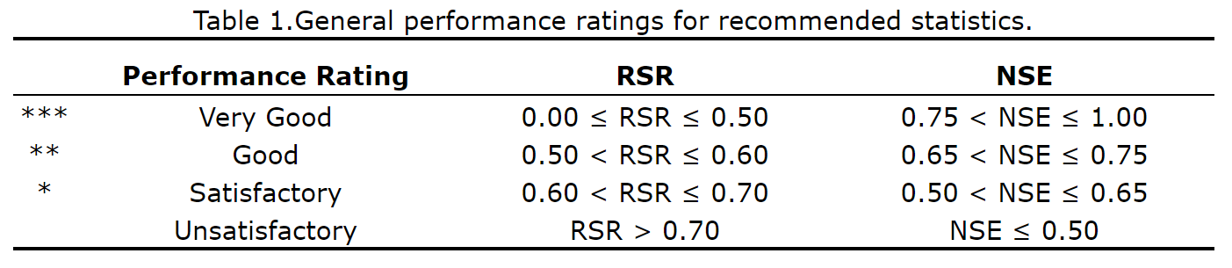
Better testing
Moriasi, Daniel, Jeff Arnold, Michael Van Liew, Ron Bingner, R.D. Harmel, and Tamie Veith. “Model Evaluation Guidelines for Systematic Quantification of Accuracy in Watershed Simulations.” Transactions of the ASABE 50 (May 1, 2007).

Slide 9
APSIM Team Strategic Plan 2021 to 2023
Strategic Priorities
APSIM is fit for purpose | Sustainable Business Model for Software Development | Ability to Deploy Models at Scale | Improved software processes within CSIRO Agriculture and Food
We’ll Achieve This By…
Ensuring that APSIM is useful (models reflect the real world with suitable level of accuracy) and reliable (models execute as intended without failure) | Recouping and managing value wherever possible and using this to resource our efforts | Building commercial services that can grow with demand through harnessing CSIRO infrastructure and skills | Providing best practice software processes and mentoring for A&F staff and collaborators
Success Looks Like…
Automated tests ensuring predictive capacity Better validation data for soil and crop model attributes that matter Better methods for quantifying model reliability (e.g. uncertainty assessment) Faster methods for model development and calibration (e.g. automated model data fusion) | More value from existing and new income streams Increase access to skilled resources Commercial IP of value is protected via effective processes Value is harvested from external projects (data, code, knowledge) Software metrics monitored to improve efficiency in software development | Important data and models available via services Every service sits within a robust software process Every service is developed within a clear IP management plan Cloud computing is readily accessible for any model application Key skills accessed from across CSIRO | Inner source approaches for internal software development Team involvement in other software projects Training provided to other staff Staff using our software processes Rapid development of quality software solutions Clear oversight by BU leadership

Slide 10
Take home messages
APSIM Next Generation is well established
APSIM Classic is not being maintained
APSIM Licence, Funding Support and CSIRO strategy require value from projects to be contributed to APSIM for the greater good.
Good things happen when we do this
Engage with the software team to ensure APSIM continues to meet your needs
Engaging team members in projects
Supporting training of your team members

